Slide 1
Diarrhoea in Children
Dr Wathsala Hathagoda
Senior Lecturer
Faculty of Medicine, Colombo
Honorary Consultant Paediatrician
Lady Ridgeway Hospital for Children

Slide 2
Outline
Definition of diarrhoea
Classification of diarrhoea
Etiological factors of diarrhoea
Pathophysiology of acute diarrhoea
Assessment of dehydration
Management of dehydration

Slide 3
Disease burden
Diarrhoea is the leading cause of child mortality in children < 5 years.
Most deaths from diarrhoea occur in children < 2 years of age living in South Asia and Sub-Saharan Africa.
Poor nutritional status worsens diarrhoeal episodes.
WHO

Slide 4
Definition
Increase in stool frequency to twice the usual number per day in infants (stool volume of more than 20grams/kg/day)
or
Three or more loose or watery stools per day in older children.
Stool consistency is more important than frequency.

Slide 5
Classification of dirrhoea
Acute diarrhoea (diarrhoea lasting less than 2 weeks)
- Acute watery diarrhoea (lasts several hours or days)
- Acute bloody diarrhoea (dysentery)
Persistent diarrhoea
Diarrhoea lasting more than 2 weeks after infection or in relation to environmental or enteric dysfunction.
Chronic diarrhoea
Diarrhoea persists for more than 2 weeks.

Slide 6
Etiology of acute diarrhoea
Viruses
Bacteria
E coli
Shigella
Salmonella
Campylobacter
Cholera
Enterotoxigenic E coli
staphylococcus
Rotavirus
Adenovirus
Calicivirus
Norovirus
Astrovirus
Coronavirus

Slide 7
Etiology of acute diarrhoea
Non GI causes
Systemic infections- meningitis, LRTI, otitis media, UTI
Surgical causes- intussusception, appendicitis, NEC
Other causes- DKA, coeliac disease, cow’s milk protein allergy, lactose intolerance
Antibiotics

Slide 8
Aetiology of chronic diarrhoea

Slide 9
Causes of chronic diarrhoea in children
Infections (amoebiasis, giardiasis)
Coeliac disease
Functional GI disorders (IBS)
Food allergies link intolerances
Inflammatory bowel disease
Small intestinal bacterial overgrowth
Cystic fibrosis

Slide 10
Pathophysiology of diarrhoea
There are 3 major mechanisms causing diarrhoea;
1. Inflammatory diarrhoea
2. Osmotic diarrhoea
3. Secretory diarrhoea
Other mechanisms;
- activation of enteric nerves through neuropeptides
- shortening of microvilli brush border membrane
- villous blunting and shortening

Slide 11
Pathophysiology ctd
Increased Cl⁻ secretion
Reduced Na⁺ absorption
Increased paracellular permeability
Reduced Cl⁻ absorption
Reduced H2O absorption
Reduced Na⁺ and glucose absorption

Slide 12
Secretory vs osmotic mechanisms
1. Diarrhoea in relation to fasting
2. Faecal anion gap
Diarrhoea cases with fasting.
Anion gap > 50
Diarrhoea persists with fasting
Anion gap < 50
Osmotic
Secretory

Slide 13
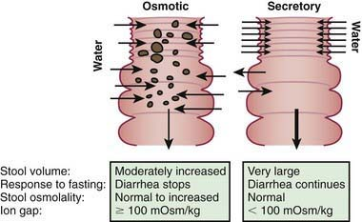

Slide 14
Osmotic diarrhoea/ diet-induced diarrhoea
Diarrhoea resulting from unabsorbed solutes or nutrients
Unabsorbed luminal substances are responsible for the accumulation of fluids in the intestinal lumen.
Diarrhoea significantly improves with fasting.
Eg: CHO malabsorption (lactose,galactose)

Slide 15
Secretory diarrhoea
Crypt secretion leads to more prominent small intestinal losses.
Does not stop with fasting
Eg: Congenital enteropathies (Congenital Na/Cl diarrhoea, tufting enteropathy)

Slide 16
Acute diarrhoea

Slide 17
Clinical presentation
Viral gastroenteritis-commonest
Fever
Watery diarrhoea
Vomiting
Abdominal cramps
Lack of appetite
Headache
Muscle aches
Lasts 3-7 days
Dysentery (bacterial)
Persistent high fever > 40⁰
Blood or mucus in stools

Slide 18
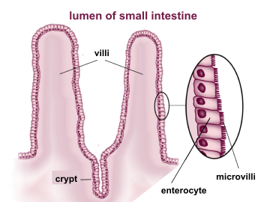
Normal intestinal epithelial cell

Slide 19
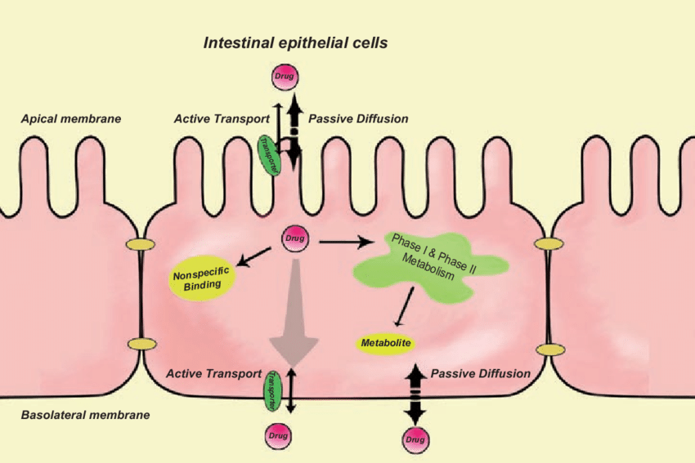
Function of the intestinal epithelial cell

Slide 20
Intestinal epithelium in gastroenteritis

Slide 21
Intestinal epithelium in gastroenteritis

Slide 22
Histology
Normal mucosa
Viral gastroenteritis

Slide 23
Management of Diarrhoea

Slide 24
Objectives of managing diarrhoea
Prevent dehydration
Treat dehydration
Prevent nutritional damage
Reduced duration, severity, and occurrence of future episodes

Slide 25
Case history
A 9-month-old girl presented with watery diarrhoea and vomiting for three days duration. She has developed a fever over the last 24 hours and passed urine only once.
On examination, she is ill-looking and irritable. She has dry oral mucosa; however, her skin turgor is < 2 seconds. Her Heart rate is 140/min, and her CRFT is 3 seconds.
What is the degree of dehydration in this baby?

Slide 26
Assessment of dehydration

Slide 27
Assessment of dehydration
The presence of two or more signs in each category will determine the degree of dehydration.

Slide 28
Assessment of dehydration
The degree of dehydration is expressed as a percentage of body weight.
“prolonged skin fold” is the best predictor
Other good predictors are
Altered neurological state
Sunken eyes
Dry mucus membranes

Slide 29
Case history
A 9-month-old girl presented with watery diarrhoea and vomiting for three days duration. She has developed a fever over the last 24 hours and passed urine only once.
On examination, she is ill-looking and irritable. She has dry oral mucosa; however, her skin turgor is < 2 seconds. Her Heart rate is 140/min, and her CRFT is 3 seconds.
What is the degree of dehydration in this baby?

Slide 30
Assessment of dehydration
No sign of dehydration < 5%
Some dehydration 5-10 %
Severe dehydration > 10 %

Slide 32
Case history
A 9-month-old girl presented with watery diarrhoea and vomiting for three days duration. She has developed a fever over the last 24 hours and passed urine only once.
On examination, she is ill-looking and irritable. She has dry oral mucosa; however, her skin turgor is < 2 seconds. Her Heart rate is 140/min, and her CRFT is 3 seconds.
How do you manage this child?

Slide 33
Setting
Hospital Inward
Hospital outpatient
Home

Slide 34
When to admit?
Systemically ill child.
Moderate to severe dehydration
Intractable vomiting
Profuse diarrhoea.
Presence of complications.
Adverse social implications.
Malnutrition.
Persistent diarrhoea.
Immunosuppressive status, including HIV

Slide 35
Investigations
Rarely helpful
Routine blood investigations are not justified
When the child is systemically ill/ likely to develop complications
- stool full report
- stool culture
- random blood sugar
- serum electrolytes
- serum creatinine
- full blood count

Slide 36
Management of dehydration
There are 3 points that is vital in the management of dehydration in children.
Correction of the existing water and electrolyte deficit
Replacement of ongoing losses
Provision of normal daily fluid requirement

Slide 37
Management of dehydration
Use of ORS to correct estimated dehydration in 3-4 hours
Continue breastfeeding throughout
Early resumption of normal diet after 4 hours of rehydration
Prevention of further dehydration by supplementing maintenance fluid with ORS
No unnecessary medications

Slide 38
Management of no dehydration
Features:
- moist mucus membranes
- normal skin turgor
- alert and responsive
Look for risk factors for dehydration
- young age
- rapid rate of fluid loss
- reduce oral intake
- underlying malnutrition

Slide 39
Management of no dehydration cont..
High risk
Admit for a period of observation
Give 10ml/kg ORS after each vomit or watery stool
- < 2years- 50-100ml
- > 2 years- 100-200 ml
Observe
Normal diet
Low risk
Normal diet and fluid
Educate
Allow home

Slide 40
Management of some dehydration
Features
- dry mucus membranes
- sunken eyes
- skin turgor (skin retraction prolonged) > 1 sec
- restless and irritable

Slide 41
Management of some dehydration cont..
Oral rehydration
- mild to moderate (5-10%) dehydration- give 75 ml/kg (50-80ml /kg)
ORS in 4 hours
- if vomiting, give little and often (5-10 ml at a time)
- consider NG infusion if vomiting persists or the child refuses ORS
Commence normal diet after initial rehydration.
Give ORS 10ml/kg for significant losses such as vomiting or diarrhoea.

Slide 42
Management of some dehydration cont..
Intravenous rehydration
- use only if oral and nasogastric rehydration failed
- cannulate
- send baseline electrolytes and blood urea
- give deficit (50-80ml/kg) over 4-8 hours
- Use 0.9% saline with 5% dextrose
- Add 10 mmol of KCL per each 500ml if serum K⁺ is not
raised

Slide 43
Management of severe dehydration
Features
- very dry mucus membranes
- sunken eyes
- skin fold retraction > 2sec
- tachycardia
- slow capillary refill
- acidotic breathing
- lethargic or comatose

Slide 45
Management of severe dehydration cont…
Management of children who present with severe dehydration and in
impending shock
- Assume 10% dehydration
- IV or intraosseus access
- Send blood urea, electrolytes, FBC, blood gas and blood culture
- Give 20ml/kg of 0.9% saline bolus
- Reaseess
- If signs of shock persist, repeat the second 20ml/kg 0.9% saline bolus
- If circulation is not restored after the second bolus
colloids
ICU admission

Slide 46
Management of severe dehydration cont…
If respond to the first bolus with the restoration of the circulation
Remaining deficit is restored with ORS
ORS 30-80ml/kg over the next 3-4 hours
Consider nasogastric tube infusion if not tolerating or refusing ORS

Slide 47
Management of severe dehydration cont…
Management of severe dehydration without shock (> 10%)
100ml/kg
IV 0.9% saline /Hartmans
 | 30ml/kg | 70ml/kg
< 1year | 1 hour | 5 hours
> 1 year | ½ hour | 2 ½ hours

Slide 48
Management of severe dehydration cont…
Replacement of ongoing losses
- Offer as much fluid as the child wants.
- Add approximately 50-100 ml of ORS (< 10 kg body weight) or 100-200 ml
ORS (> 10 kg body weight) for each stool.
- Depending on the stool volume, fluid intake should be increased.
Provision of normal daily fluid requirement
- Breastfeeding should be continued. - If on formula milk, continue in the same dilution. - Offer as much fluid as possible to drink in addition to ORS solution.

Slide 49
ORS (Oral Rehydration Solution)

Slide 50
ORS (Oral Rehydration Solution)
Absorb through the small intestine
Na⁺ /glucose co-transport mechanism is important
Water follows the solute gradient (passively)
Faster rehydration
Less complications
Overall failure rate for ORS is 3.6%
Less cost
Easily available

Slide 51
Disadvantages/ reasons for failure of ORS
Tolerance
Vomiting
Refusal to drink
Glucose malabsorption
Preparation
Storage
Cost-effectiveness ratio
Perceived to fail to cure diarrhoea

Slide 52
Types of ORS
Rice-based ORS
Reduced stool output in cholera patients
No added advantage in paediatric practice
Flavoured ORS
Adding juices to ORS changes its composition
ESPHGHAN guidelines to flavoured ORS

Slide 53
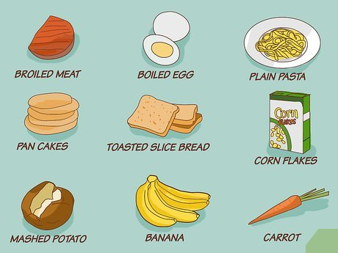
Feeding
Continue breastfeeding throughout the dehydration and maintenance phase of breastfed children.
Children who are on a weaning diet should receive a normal diet once rehydrated

Slide 54
Feeding cont…..
Advantages
- minimise protein energy deficit
- reduces stool losses
- stimulate normal restoration of villi
- shorter duration of diarrhoea

Slide 55
Relationship between diarrhoea and malnutrition
Decreased nutrient intake
Impaired barrier protection
Infection
Malabsorption
Malnutrition
Increased catabolism
Impaired immune function

Slide 56
Energy requirement
Need increased levels of nutrients.
- impaired intestinal absorption
- elevated metabolic rates
- tissue repair (including catch-up growth)
Energy- at least 25% more than the mean requirement
Protein- at least twice the recommended allowance

Slide 57
Zn supplementation
Should start as soon as possible
Need to continue 10-14 days
Dose 10-20mg/day. (< 6 months- 10 mg/day , > 6 months 20 mg/day)
Advantages
- reduces the duration
- reduces the severity
- reduces the risk of recurrence for the next few months

Slide 58
Probiotics
Live micro-organisms
Lactobacillus GG is the most commonest used with proven efficacy
Saccharomyces boulardi is also shown to be effective
Most of the other strains offer no benefit
Known to reduce the duration of diarrhoea
They are adjuncts to ORS

Slide 59
Anti diarrhoeals
Never indicated for the treatment of acute diarrhoea in children.

Slide 60
Anti emetics
If vomiting is the predominant feature, antiemetics may be prescribed to assist oral rehydration.

Slide 61
Antibiotics
Majority of childhood diarrhoea is viral origin and does not require antibiotics.
Only indicated in invasive diarrhoea (shigella/ salmonella/ E- coli/amoeba/ giardiasis/ cholera) , need treatment with antibiotics on suspicion.

Slide 63
Summary
Diarrhoea is a common problem in children
Watery diarrhoea is mostly due to viral infections
Assessment of dehydration should be done using WHO criteria and categorise children into the approprate management plan
ORS should be given to all children for rehydration and maintenance
IV fluid only indicated in severe dehydration
Zn and probiotic have some therapeutic effect
Normal feeding should start as soon as possible

