Slide 1
Inflammatory Bowel Disease in Children
Dr Wathsala Hathagoda
MBBS (Kel), DCH (SL), MD (Paeds), DCH (UK), MRCPCH (UK)
Consultant Paediatrician
Lady Ridgeway Hospital for Children
Lecturer, Faculty of Medicine, University of Colombo

Slide 2
Outline
Epidemiology
Pathophysiology
Clinical presentation
Evaluation
Medical management
Surgical management

Slide 5
Epidemiology
Global incidence of CD is 0.1-13.9/100000
Regions with highest incidence of CD are North America (13.9/100000) and Europe (12.9/100000)
The world burden of IBD is on the rise simply due to growing number of CD across the world
The time-trend analysis illustrated stable incidence in North America, Europe and an increasing incidence in newly industrialized countries in Asia, the Middle East and Africa

Slide 6
Epidemiology
Ulcerative colitis is more prevalent than Crohn’s disease
North America and northern Europe have the highest incidence and prevalence rates of ulcerative colitis,
Ulcerative colitis has a bimodal pattern of incidence, with the main onset peak between ages 15 and 30 years, and a second smaller peak between ages 50 and 70 years.
A family history of inflammatory bowel disease is the most important independent risk factor. The risk is particularly high in first-degree relatives: 5·7–15·5% of patients with ulcerative colitis have a first-degree relative with the same disease

Slide 7
Pathogenesis

Slide 8
Pathogenesis: Altered gut microbiome
Microbiome of children with IBD is a characterized by low bacterial diversity and associated reduction in microbial gene diversity leading to loss of function.
Increase pathogenic bacteria and loss of friendly colonies.
The possible changes include
Increased in Bacteroids (Detrimental)
Increased in E coli (Detrimental)
Reduced Fermicutes (Detrimental)
Increased Faecalibacterium (Beneficial)
It is possible that the altered microbiome interact with immune mechanism contributing to the pathogenesis

Slide 9
Pathogenesis: Genetic Mechanisms
First susceptible gene for ileal Crohns NOD 15 was described in 2001
Since then a at least 240 genes have been described in association with IBD
Some of the identified genes include
Autophagy genes (NOD 15, ITLN1)
Immune dysregulation (mutations in IL-10, IL-10RB, IL-23)
VEOIBD is always associate with genetic mutation and immunodeficiencies
Monozygotic twins exhibit phenotypic concordance in 50–70 % of CD patients, and their relative risk of developing CD is 800-fold greater compared to the general population.

Slide 10
Pathogenesis: Environmental Factors
Following environmental factors influence pathogenesis of IBD
Smoking
Gastrointestinal infections
Stress
Air pollution
Appendicectomy
Living in urban area
No breast feeding
Exposure to antibiotics in early life

Slide 11
Pathogenesis: Immune Dysregulation
In the normal gut mucosa there is a dynamic interplay between appropriate response to mucosal immune stimulation and down-regulatory forces mitigating accompanying tissue injury
This balance is altered in CD
Proinflammatory Th1 and Th17 response is highly expressed in CD
Th1 cells secret TNF-α which is associated with mucosal damage
Th17 cells secret IL 10 and 23 which are important in the pathogenesis

Slide 12
Clinical Picture
CD is characterized by
Transmural inflammation
Extension from mouth to anus
Terminal ileum is the commonest site in children
About 60% of children have extensive ileocecal involvement
Isolated colonic disease is noted in 20-30%
CD can present in any age
Involvement of the upper gastrointestinal tract is more common compared to adults

Slide 13
Ulcerative colitis
Chronic relapsing inflammatory condition of the colon, extending continuously from the rectum proximally to a varying degree
Caused by impairment in immunological tolerance, resulting in an exacerbated immunoreaction against intestinal microbiota in genetically susceptible individuals

Slide 14
Clinical features
Gastrointestinal manifestations
Abdominal pain
Involuntary weight loss
Bloody diarrhea
Nocturnal diarrhea
Perianal fisulae
Nonhealing anal fissures, tags
Abdominal mass
Anaemia
Extraintestinal manifestations
Low grade fever
Erythema nodosum
Pyoderma gangrinosum
Arthritis
Jaundice
Growth retardation
Delayed sexual maturity
Clubbing
Persistent conjunctivitis

Slide 15
Clinical Features: Growth Faltering
Defined as
Linear growth at or below 2 SD for the age
Decreased growth velocity
Is seen in at least 15-20% of children with CD
Reasons
Malnutrition
Poor intake
Increase GI losses
Malabsorption
Inhibition of IGF-1 by TNF-α and IL-6
Often associated with delay in puberty

Slide 16
Differential diagnosis
Infectious colitis (Yersinia, c. difficile, CMV,amoebiasis)
Allergic colitis (CMPA- specific or total IgE, elimination diet, skin prick test
Vasculitis (extra-intestinal involvement-HLA B5, serological markers)
Immunodeficiency states (CGD, WAS, CVID)

Slide 17
Diagnosis
Combination of history, physical and laboratory examination, Upper GI endoscopy + ileo-colonoscopy with histology and imaging of the small bowel.
Need to exclude enteral infections.

Slide 18
Laboratory tests
It is critical to exclude enteric infections (C. dif, Viral and bacteria)
The initial blood tests should include the following parameters:
FBC, at least two inflammatory markers (CRP, ESR), albumin,
transaminases (AST, ALT), GGT.
Serological markers of IBD (ASCA, p- ANCA) may increase the likelyhood for IBD in case of positive results.
Faecal markers of inflammation (lactoferrin/ calprotectin) are very sensitive to detect mucosal inflammation but not specific for IBD.
** normal valuees make active disease in the small or large bowel unlikely.

Slide 19
Endoscopy
OGD and illeocolonoscopy are recommended as the initial workup in all patients.
Multiple biopsies should be obtained from all sections of the GI tract, irrespective of macroscopic appearance.

Slide 20
UC at Endoscopy
A- mild (erythema, lost VP,
granularity)
B- moderate (A + erosions)
C- severe (ulcers)
D- severe wih free bleeding
F- disease effects (luminal,
pseudopolyps)

Slide 21
CD at colonoscopy
A- Cobblesoning
B- Longitudinal ulcer
C- Mucosal healing with scar from
longitudinal ulcer

Slide 22
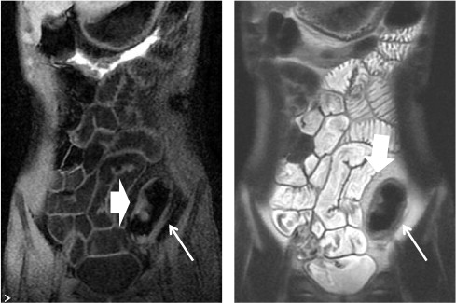
Imaging - MR Enterography
Imaging modality of choice in
paediatric IBD diagnosis.
may detect inflammatory changes
in the small intestinal wall and
identify disease complications
(fistulae, abscesses, stenosis).
preferred over CT due to lack of
radiation and high accuracy.

Slide 23
Imaging- Wireless Capsular Endoscopy (WCE)
Useful to identify small bowel mucosal lesions in children suspected CD, in whom conventional endoscopy and imaging tools have been non-diagnostic.
Normal WCE has a very high negative predictive value

Slide 24
Additional Tests for VEOIBD

Slide 25
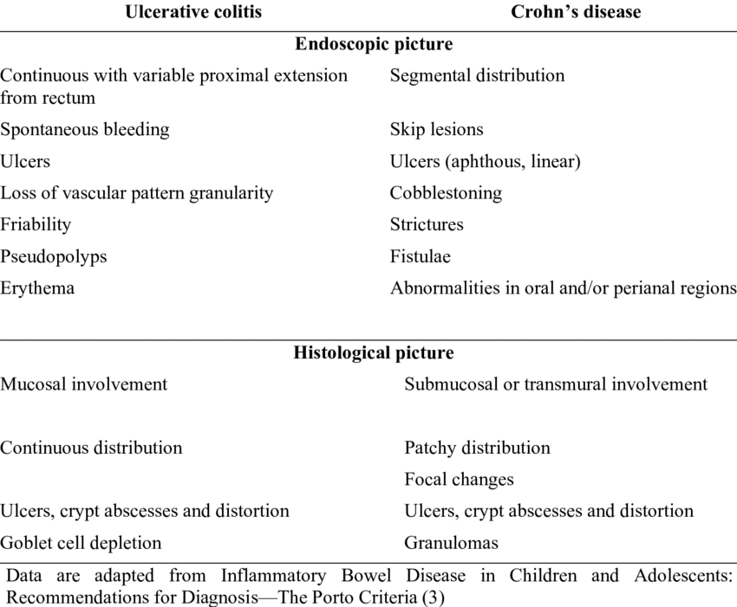

Slide 26
Diagnostic Workup (Revised Porto Criteria 2014)

Slide 27
Management of IBD
Medical management

Slide 28
Aims of Management
Deep mucosal healing
Achieve long lasting remission
Optimize growth
Improve health related quality of life
Maintain optimal bone density

Slide 29
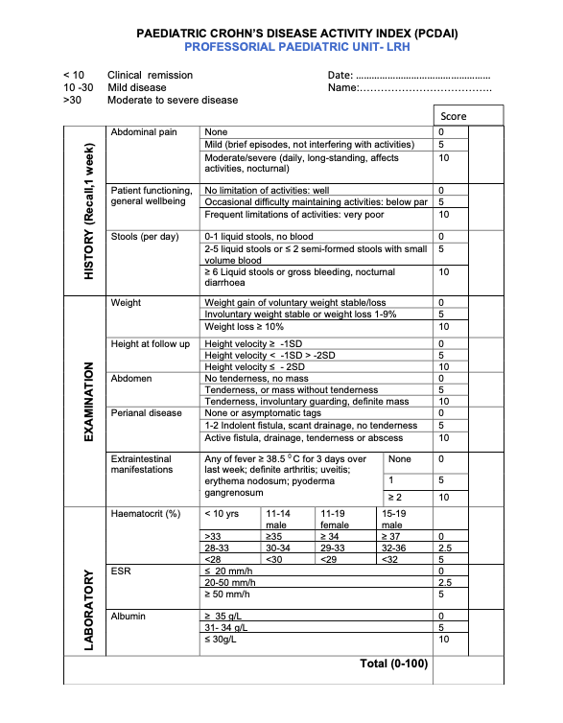

Slide 31
British Society of Paediatric Gastroenterology, Hepatology and Nutrition (BSPGHAN) Guidelines on IBD

Slide 32
Steroids for Remission Induction
Steroids are indicated in remission induction for moderate to severe disease when EEN is not available or not tolerated
Predinisolone is the drug of choice
Dosage is 1mg/kg or 40 mg/day maximum
May increase up to 60 mg/day when the response is unsatisfactory
Intravenous steroids are recommended when oral steroids failure
Gradually tail off

Slide 34
Budesonide
A useful drug in mild-moderate ileal CD and disease proximal to the hepatic flexure
Two commercial types are available and both have the ability to release the active drug in a pH dependent manner.
Excellent local effect with minimal systemic bio-availability
Efficacy of induction of remission at 8 weeks is 42-55% in 2 studies
Dose would be 9 mg per day or 12 mg per day
Less effective than prednisolone but with a better side effect profile

Slide 35
Exclusive Enteral Nutrition (EEN)
It involves the use of a complete liquid diet, with the exclusion of normal dietary components for a defined period of time, as a therapeutic measure to induce remission in active CD
Three basic types
Polymeric
Semi-elemental
Elemental
The difference depends on the size of the protein molecules and how broken down the protein is

Slide 36
Exclusive Enteral Nutrition (EEN)
EEN is the first line therapy for CD in most of the centers where the facilities are available
EEN
Induce mucosal healing
Restore bone mineral density
Improve the growth
Duration is 6-8 weeks
Should be used as a whole protein formula
Elemental formulae are used only when associated other conditions
Poor response by 2 weeks; change to an alternative drug

Slide 37
Exclusive Enteral Nutrition (EEN)
Polymeric feedings are better tolerated, more cost effective, and less often require naso-gastric tube feeding
Aim to achieve 120% of caloric intake
No studies to state the best approach
Effective regardless the site of the disease
Mucosal healing is superior to prednisolone (74%vs 33%)
Duration of remission is controversial

Slide 38
Maintenance of Remission

Slide 39
Thiopurines
Thiopurines (azathioprine or 6-mercaptopurine) are recommended as one option for maintenance of steroid free remission in children at risk for poor disease outcome
Thiopurines alone are not recommended as induction therapy

Slide 40
Thiopurines
The recommended azathioprine dose is 2.0–2.5 mg/kg, and for its prodrug, 6-mercaptopurine, 1.0–1.5 mg/kg once daily
Full does to be started at the outset and maximum therapeutic efficacy comes between 8-14 weeks
Periodic monitoring of complete blood count and liver enzymes is mandatory during the first month, initially every 1–2 weeks with decreasing frequency thereafter, but continuing for duration of therapy once every 3 months in all patients on thiopurine
Determination of thiopurine metabolites (6TGN and 6MMP) should be considered in patients with elevated Alanine transaminase (ALAT), cytopenia, or in suboptimal response and to monitor compliance

Slide 41
Thiopurines: Benefits and Risks
After induction of remission with prednisolone, the relapse rates are 4% and 9% in 6-MP group compared to 26% and 47% in the placebo group at 6 and 18 months (Marcowitz Trial)
AZA has been associated with prolonged maintenance of remission, decreased rates of hospitalization, corticosteroids use, and surgery
Associated long term problems include
Pancreatitis
Flu like illness
Hepatotoxicity
Myelosupression
Lymphoma (4.5/10000 cases)
Hepatosplenic lymphomas (40 cases around the world)
Non melanotic skin cancers

Slide 42
Methotrexate
MTX is prescribed as 15 mg/m² (body surface area) once a week to a maximum dose of 25 mg
Administrates via subcutaneous route
Need concomitant administration of folate
Several trials have shown its efficacy of maintaining remission in 50-80% of cases when Thiopurines are ineffective or not tolerated
Few trials on oral MTX for children with less severe activity
Adverse effects include
Nausea/vomiting
Flu like illness
Hepatotoxicity
Myelosuppression
Pulmonary toxicity

Slide 43
Anti-TNF Agents

Slide 44
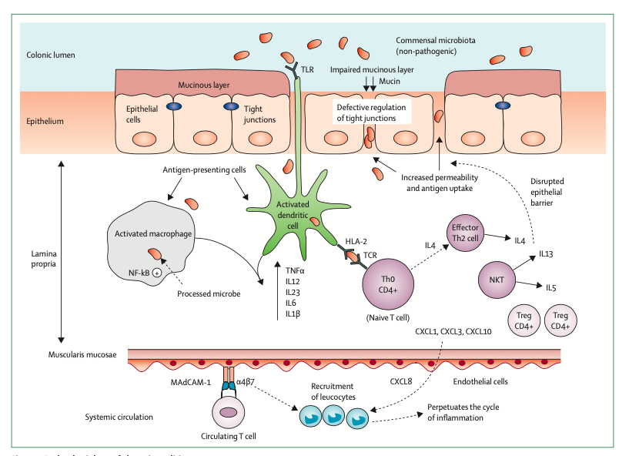

Slide 45
Anti-TNF Agents
Recommended for
Inducing remission in active steroid refractory disease
Inducing and maintaining remission in chronically active luminal disease
Active perianal fitulating disease
Severe extraintestinal manifestations (arthritis, pyoderma gangrinosum)
In a new case of CD both Infliximab (IFX) and adalimumab (ADA) have similar efficacy
Testing for tuberculosis before initiating therapy is mandatory
IFX should be given at 5mg/kg with 3 induction doses over 6 weeks (0,2,6) followed by maintenance therapy of 5 mg/kg every 8 weekly
ADA is given at 2.4 mg/kg at base line, 1.2 mg/kg at 2 weeks and 0.6 mg/kg every other week

Slide 46
Anti-TNF Therapy
Switch form IFX to ADA is considered when patient is intolerant to IFX or loss of response
Once sustained remission is achieved, it is maintain with IFX or step down to Azathioprine or MTX
Ideally, serum levels need to be monitored
Remission rate of 88% is noted after 0,2,6 weeks therapy with IFX
Long term remission maintenance rate ranges from 56%-61%
Significant corticosteroids sparing effects had been noted in REACH and GFHGNP trials
Mucosal healing around 70% in several trials
Reduces need for surgeries

Slide 47
Anti-TNF Therapy
In the maintenance phase, IFX can be used as a monotherapy or combine with Azathioprine
However monotherapy with IFX alone is very effective
Combination therapy increases the risk of high grade lymphomas
Adverse effects
Hypersensitivity reactions
Increase incidence of infections (acute and opportunistic)
Hepatosplenic T cell lymphoma

Slide 49
Fistulating Crohns Disease

Slide 50
Perianal Crohns Disease
Presents with perianal fistulae
May associate with recto-vesicular and recto-vaginal fistulae
Consider as severe disease
Management options
Surgical drainage if there is associated abscess
Ciprofloxacin
Metronidazole
IFX
ADA alone or combined with Ciprofloxacin
Need careful follow up

Slide 51
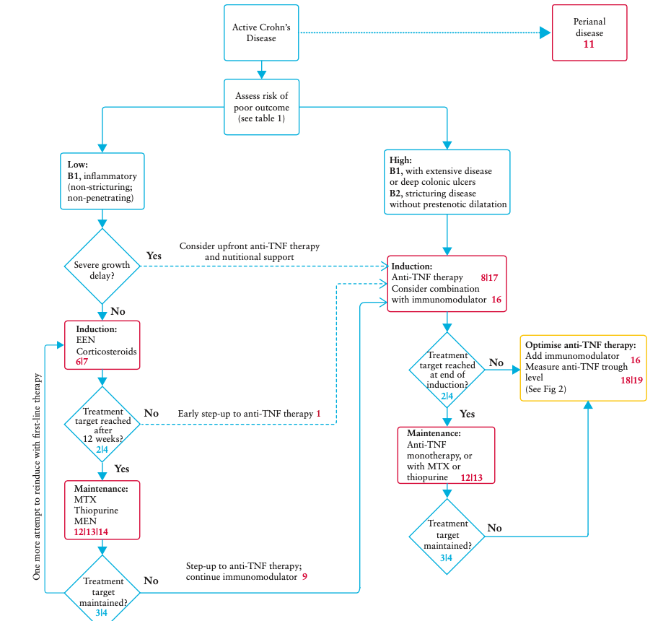

Slide 53
British Society of Paediatric Gastroenterology, Hepatology and Nutrition (BSPGHAN) Guidelines on IBD

Slide 54
Mild to Moderate colitis
First line induction and maintenance of remission: Oral 5-ASA
Sulfasalazine (40-70mg/kg/day) in 2 divided doses (max4g/day)
Mesalazine (60-80mg/kg/day) in 2 divided doses (max 4.8g/day)
Blockade of IL-1, TNF-⍺ receptors, pro inflammatory prostaglandin, leukotrienes
Topical/Rectal therapy- mild to moderate proctitis
Rectal 5-ASA enemas 25mg/kg day in once a day (max 1g/day)
Rectal steroids

Slide 55
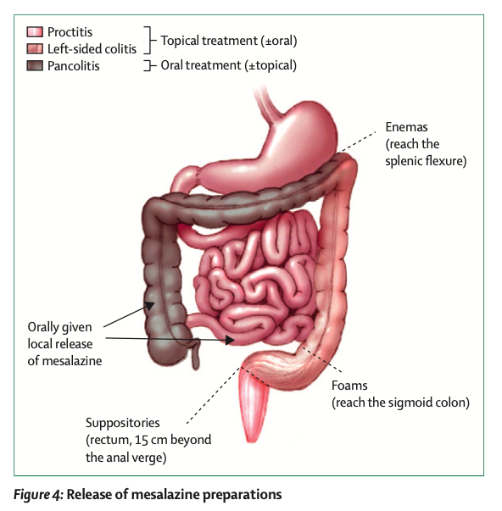

Slide 56
Moderate-severe colitis oral steroids- prednisolone
Effective for inducing remission
But not for maintaining remission
Inhibit protein synthesis which down regulate pro-inflammatory cytokines (TNF- ⍺, IL-1, IL-6)
Recommended in moderate disease with systemic symptoms and severe disease without systemic symptoms
Dose of prednisolone 1g/kg up to 40mg OD in the morning
Total duration 10-12 weeks

Slide 57
Acute Severe colitis (PUCAI >65)
IV methylprednisolone 1 mg/k/day (up to 40 mg/day) once daily in the morning is recommended as the initial treatment
a higher dose of 1.5 mg/k/day (up to 60 mg/day) in 1 or 2 divided daily doses should be reserved to the more severe end of the spectrum and for children who have failed oral steroids before admission
AXR should be performed with a low threshold in children with abdominal tenderness or distension, significant pain and those with systemic toxicity

Slide 58
Toxic megacolon

Slide 59
Management of toxic megacolon
IV fluid resuscitation
IV corticosteroid
IV antibiotics- ampicillin, gentamicin, metronidazole (covering gram negative and anaerobic bacteria)
Bowel rest
NG decompression
preparation for surgery

Slide 60
Second line medications

Slide 61
Immunomodulators
Thiopurines (azathioprine/mercaptopurine)
Inhibit the proliferation of T and B lymphocytes result in reduction in cytotoxic T cells
Ineffective for induction of remission
Indications
- children with 5-ASA intolerance
- those with frequently relapsing (2-3 relapses/year)
- steroid-dependent disease
- maintenance treatment after inducing remission by steroids in acute severe colitis

Slide 62
Immunomodulators ctd
Therapeutic effect may take up to 10-14 weeks after starting treatment
Dose
- Azathioprine 2.5mg/kg OD
- Mercaptopurine 1-1.5mg/kg OD
Testing the activity of the enzyme: thiopurine methyltransferase (TPMT) is recommended to guide the dose to avoid SEs
Measurement of metabolites of thiopurines 6-MMP and 6-TG may be helpful in assessing compliance and to assess possible toxicity

Slide 63
should be discontinued in significant myelosuppression, hepatotoxicity, pancreatitis
fever, pancreatitis, rash, nausea, vomiting, diarrhea, arthralgia (dose- independent SEs)
Leucopenia, thrombocytopenia, infections, hepatitis, pancreatitis (dose dependent SEs)
Increase the risk of non-Hodgkin lymphoma and T-cell lymphoma (HSTCL)

Slide 64
Biological Agents 1. Infliximab 2. Adalimumab
TNF is produced by macrophages, fibroblasts, adipocytes and T cells and acts as a pro-inflammatory cytokine
Monoclonal antibodies targeting TNF ⍺
Indications
- children with persistently active, or steroid-dependent
UC, uncontrolled by 5-ASA and thiopurines
- steroid refractory disease
Adalimumab should only use in those who intolerant to Infliximab or those who lost response

Slide 65
Infliximab (IFX)
First line biological agent in pediatric UC
Recombinant chimeric monoclonal antibody
Effective in inducing clinical remission, promoting mucosal healing and reducing the need of colectomy
Administered at 5mg/kg (3 induction doses >6 weeks followed by 5mg/kg every 8 weeks for maintenance)
Monitor serum IFX levels and Abs to IFX
When IFX levels low and IFX abs negative- dose escalation is indicated
IFX levels undetected in the presence of IFX abs- loss of response (dose escalation or switching to a different drug)

Slide 66
Adalimumab
Fully human recombinant IgG
Started at 100mg/m² up to 160mg, followed by 50mg/m² up to 80mg after 2 weeks and then 25mg/m² up to 40mg every other week

Slide 67
Iron deficiency anaemia
70% of children with IBD are anaemic due to malabsorption, blood loss and inflammation.
Anaemia can delay recovery from flare-ups and cause fatigue, delayed healing, hair loss, tongue soreness, or pica.
Ferritin is an acute-phase protein: levels of under 100 µg/l may reflect iron deficiency in the presence of inflammation

Slide 68
Iron deficiency anaemia ctd
Hepcidin is peptide produced by the liver that has broad antibacterial and antifungal actions, part of the first line of defence at mucosal barriers. Hepcidin inhibits the intestinal absorption of iron. Hepcidin levels rise with infection or inflammation, and fall with hypoxia or anaemia.
Consider intravenous iron – in severe anaemia, or patient preference, but beware severe hypersensitivity reactions.

Slide 69
Management ctd
Monitoring nutritional status and growth is important
Bone mineral status should be assessed using DEXA
Psycological intervention to improve quality of life: coping skills, and depression
Poor drug compliance in children and adolescent
Transitional care

Slide 70
Management Surgical management

Slide 71
Elective colectomy may indicated in children with active or steroid-dependent UC despite maximal treatment with 5-ASA, thiopurines and anti-TNF therapy
Or colonic dysplasia
Proctocolectomy (ileonal pouch or ileal pouch-anal anastomosis)J-pouch is preferred

Slide 72
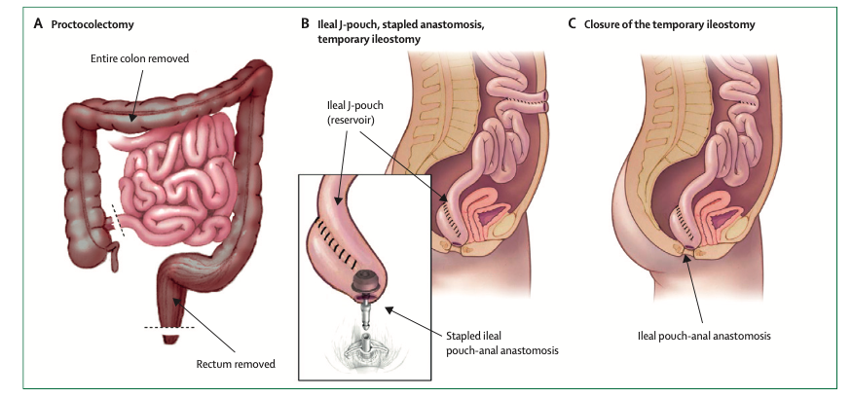

Slide 73
THANK YOU

